Slide 1
Macro mobility : MIPV6
With the increasing demands for new data and real-time services, wireless networks should support calls with different traffic characteristics and different Quality of Service (QoS) guarantees.
IP has been recognized to be the de facto protocol for next-generation integrated wireless network
For efficient delivery of services to the mobile users, the next-generation wireless networks require new mechanisms of mobility management where the location of every user is proactively determined before the service is delivered.Efficient handoff mechanisms are essential for ensuring seamless connectivity and uninterrupted service delivery
Different mobility management frameworks can be broadly distinguished into two categories - micro-mobility and protocols for inter-domain or macro mobility.
The macro mobility mechanism takes care of global mobility where the mobile moves between administrative domains

Slide 2
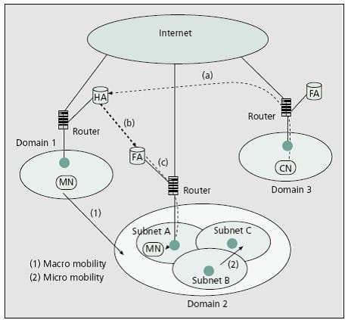

Slide 3
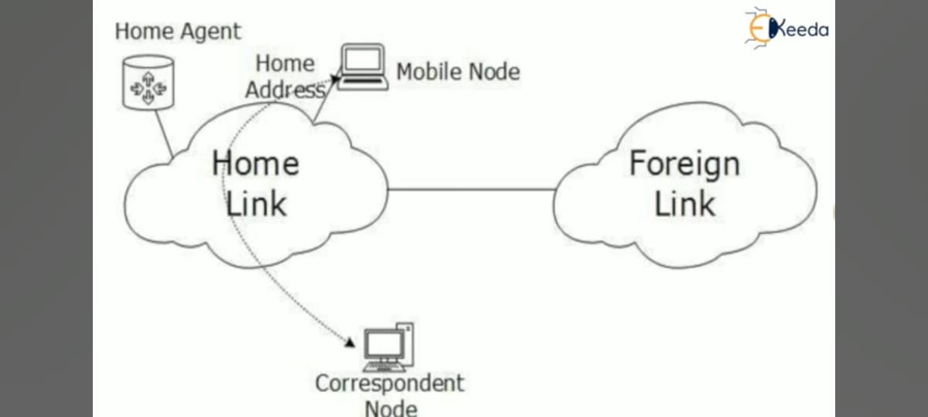
Mobile IPv6 provides mobility support for IPv6. It allows you to keep the same internet address all over the world, and allows applications using that address to maintain transport and upper-layer connections when changing locations. It allows mobility across homogenous and heterogeneous media.
For example, Mobile IPv6 facilitates node movement from an Ethernet segment to a wireless LAN cell while the mobile node's IP address remains unchanged.
In Mobile IPv6, each mobile node is identified by two IP addresses: its home address and its care-of address. The home address is a permanent IP address that identifies the mobile node regardless of its location. The care-of address changes at each new point of attachment and provides information about the mobile node's current situation. When a mobile node arrives to a visited network, it must acquire a care-of address, which will be used during the time that the mobile node is under this location in the visited network
When a Mobile Node leaves its Home Link and is connected to some Foreign Link, the Mobility feature of IPv6 comes into play. After getting connected to a Foreign Link, the Mobile Node acquires an IPv6 address from the Foreign Link. This address is called Care-of Address. The Mobile Node sends a binding request to its Home Agent with the new Care-of Address. The Home Agent binds the Mobile Node’s Home Address with the Care-of Address, establishing a Tunnel between both.

Slide 4
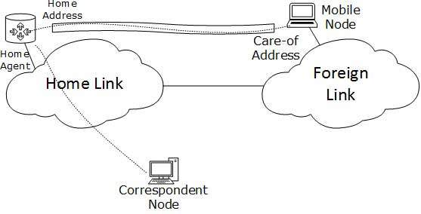
Home Agent
Mobile Node
Care Of Address
Binding update
Optimization Routing
Tunneling
Reverse Tunneling

Slide 5
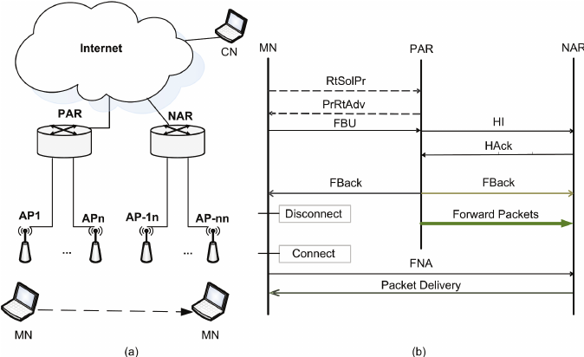
FMIPv6 structure and operation sequence

Slide 6
How FMIPv6 works:
Movement Detection: The mobile node detects that it is about to move to a new subnet or access point. This can be based on various triggers, such as signal strength, proximity to a new access point, or other network metrics.
Handover Initiation: The mobile node sends a Fast Binding Update (FBU) message to its home agent and correspondent nodes, informing them of its intention to handover. This allows the network to prepare for the handover before the actual movement occurs.
Handover Execution: Once the mobile node moves to the new subnet or access point, it completes the handover process by updating its IP address and establishing new communication paths with its correspondent nodes.
Optimized Routing: During the handover process, packets destined for the mobile node are redirected to its new location using optimized routing mechanisms, reducing packet loss and minimizing service disruption.

